Slide 1
MFSK Results and Analysis from UNET2015 Trials

Slide 2
CONTENTS
About MFSK
FSK in UNET Modems
Design of the MFSK Algorithm used
BER Results
Signals Analysis Results
Further Performance Improvements

Slide 3
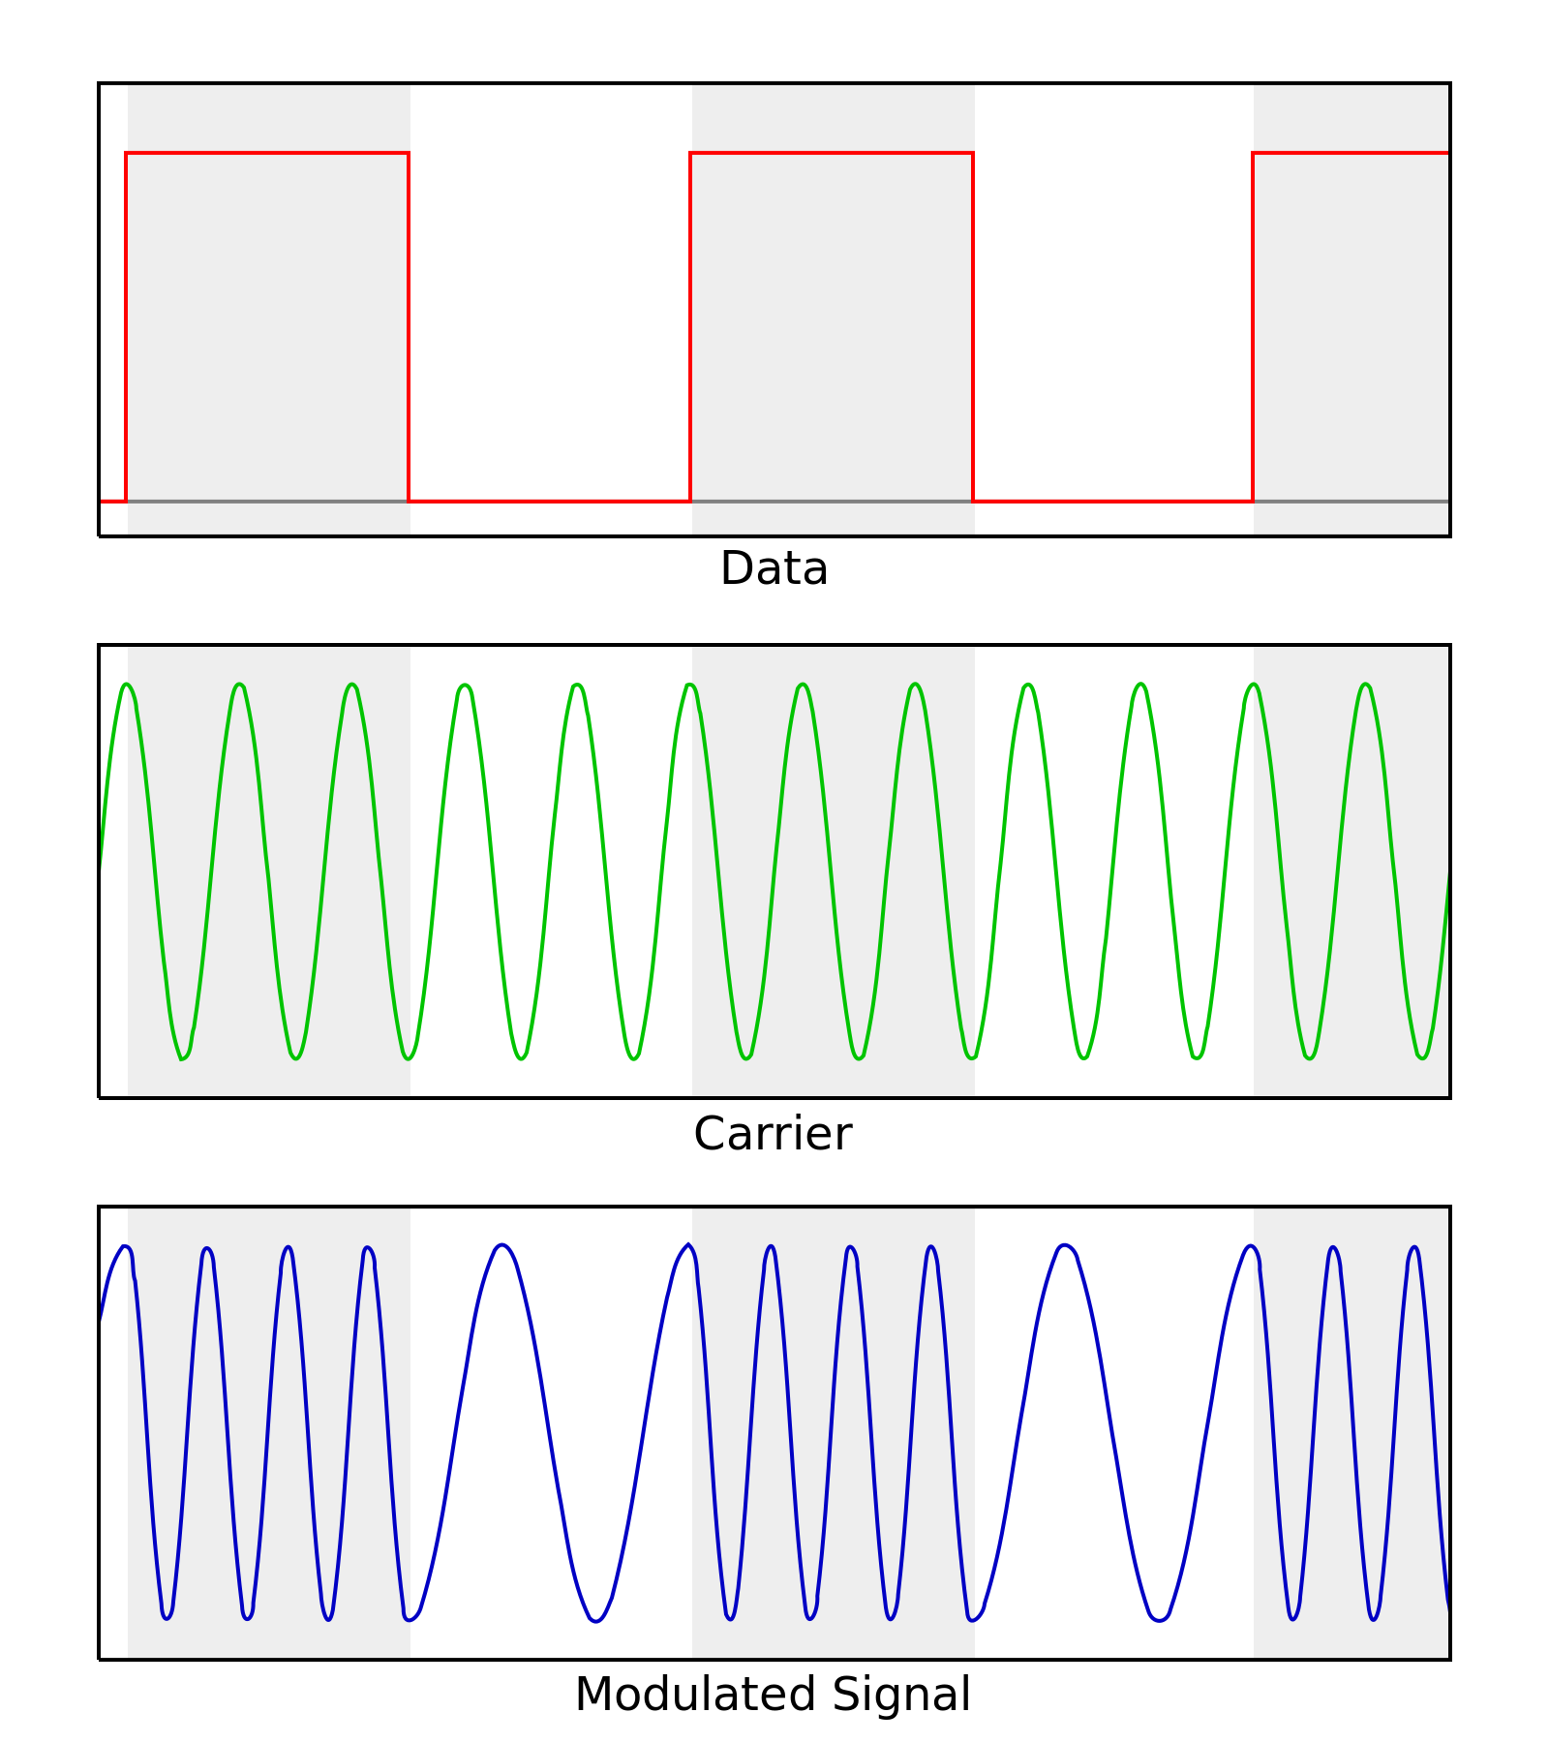
ABOUT MFSK
Frequency Shift Keying (FSK) – use frequency to send information about bits
BFSK – Binary FSK , all 1 bits sent at frequency f1 and all 0 bits sent at frequency f2
MFSK – M-ary FSK, log₂M bits information sent at one of M frequencies e.g: 4-ary FSK – 2 bits tx on one of 4 frequencies

Slide 4
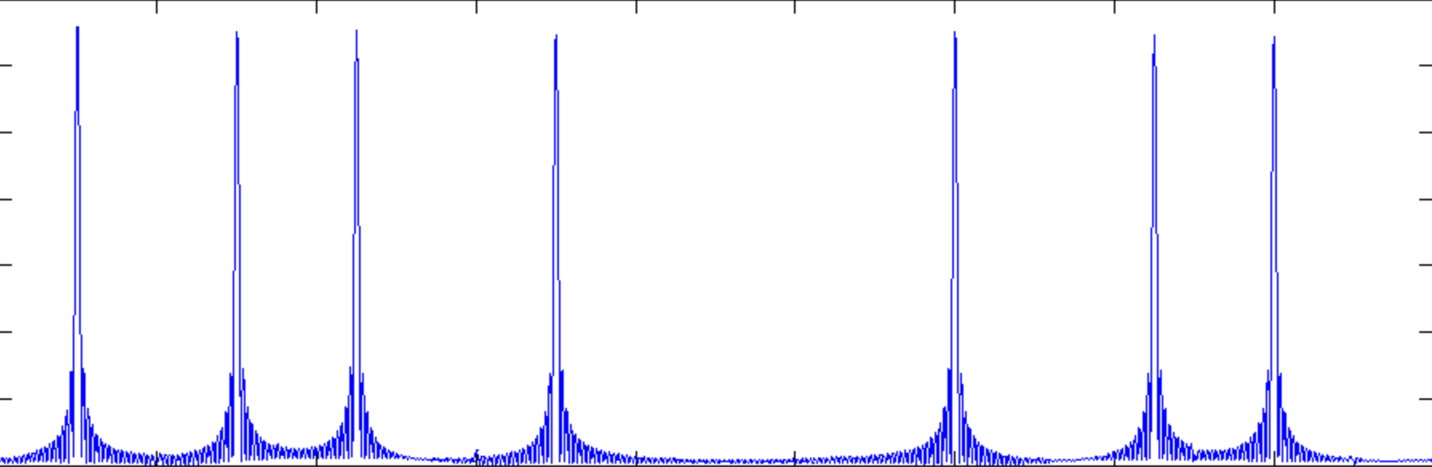
FSK IN UNET MODEMS
First BFSK algorithm implemented based on WHOI specifications : 80/160 sbs with 80/160 freq steps and 7/13 frequency hops, single bit per symbol
A modified version of BFSK implemented
Transmit multiple bits per symbol, use multiple bands in the bandwidth with a single bit information stored in each band
JANUS based BFSK implemented

Slide 5
DESIGN OF MFSK ALGORITHM
4 configurable parameters : bits per frequency - M total available bandwidth – BW symbol rate - S frequency gap - F
Multiple bits per symbol
Bands available for transmission : BW/(F * 2^{M})
(Fs/S) samples generated for M bits set for each band
Samples from each band added together to form a single symbol

Slide 6
RESULTS
Tests conducted over 2 days at 3 different ranges - Day 1 : Test 1 at range of 1923 mtrs Test 2 at range of 753 mtrs -Day 2 :
Test 1 at range of 1923 mtrs Test 2 at range of 2300 mtrs
Different configurations of the MFSK parameters tried
The following graphs show BER variations for multiple configurations and signal analysis for configuration of 500 Hz frequency separation, 50 symbols per second, 14 KHz bandwidth and 2 bits per frequency and packet length of 80 bytes

Slide 7
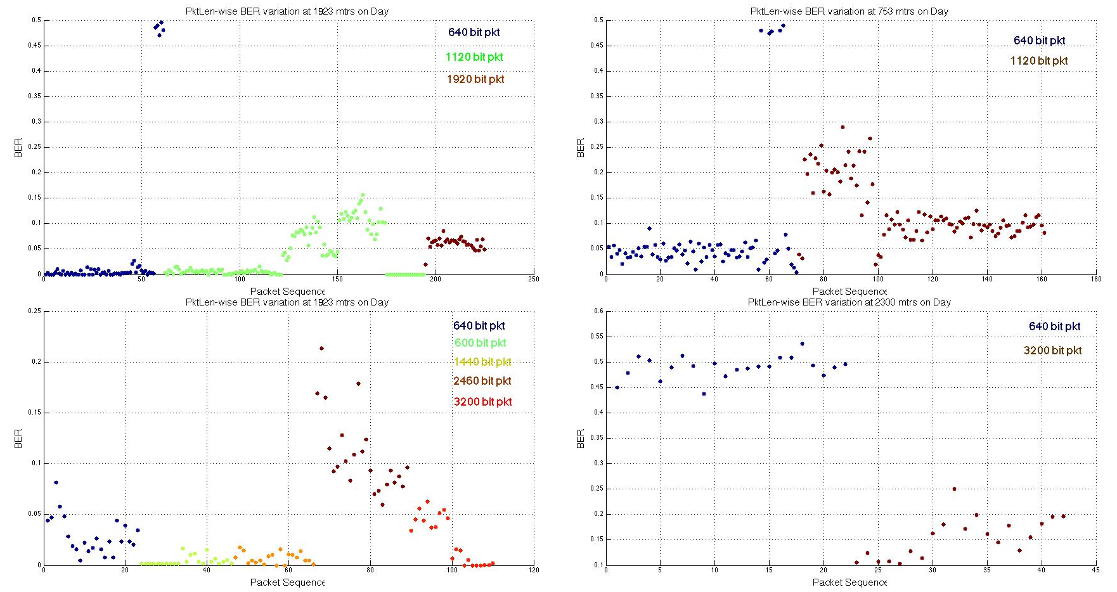
BER PER TEST FOR DIFFERENT PACKET LENGTHS

Slide 8
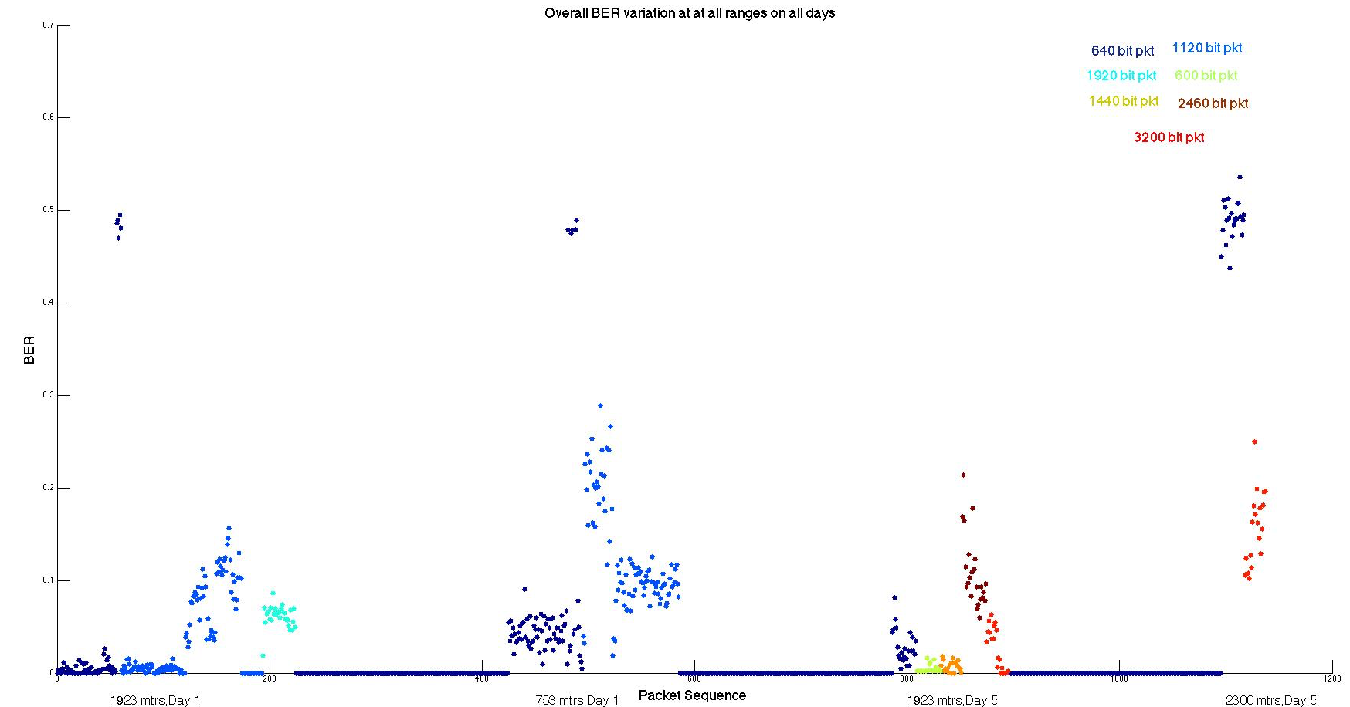
OVERALL BER FOR ALL TESTS

Slide 9
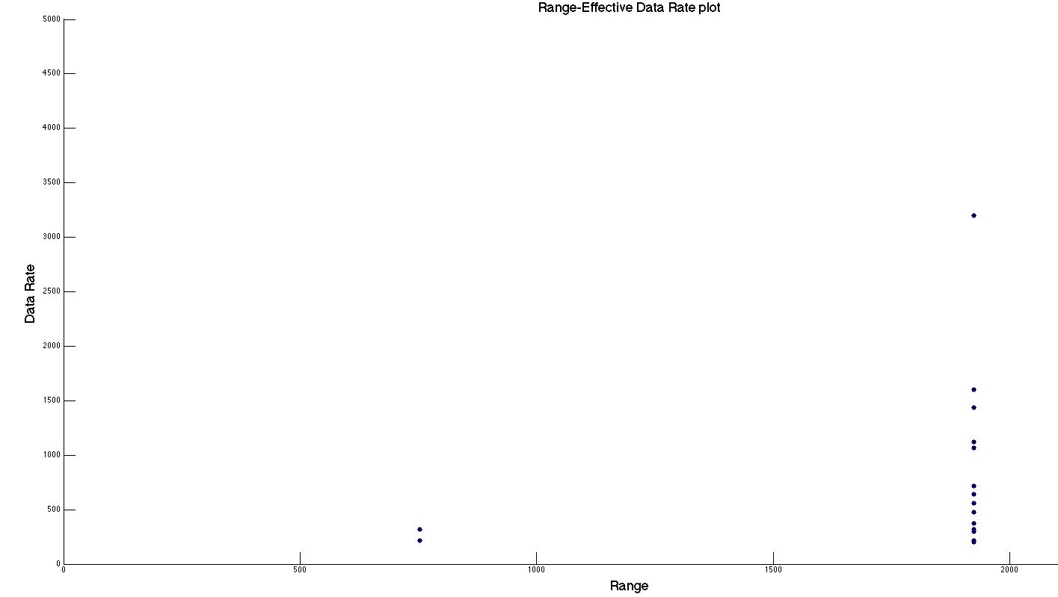
EFFECTIVE DATA RATES

Slide 10
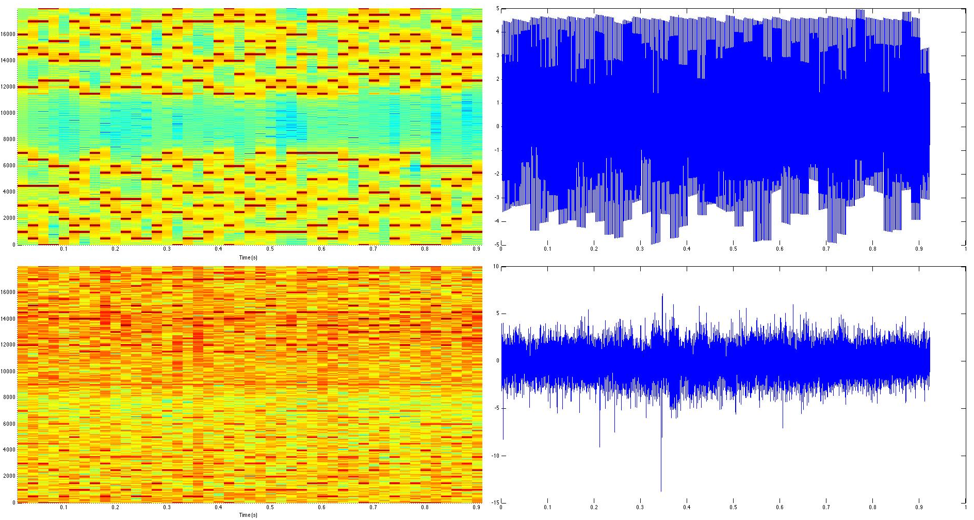
SPECTROGRAM FOR LOW BER SIGNALS
Transmitted Signal
Received Signal

Slide 11
POWER SPECTRUM OF LOW BER SIGNALS
Transmitted Signal
Magnitude
dB scale
Received Signal
Magnitude
dB scale

Slide 12
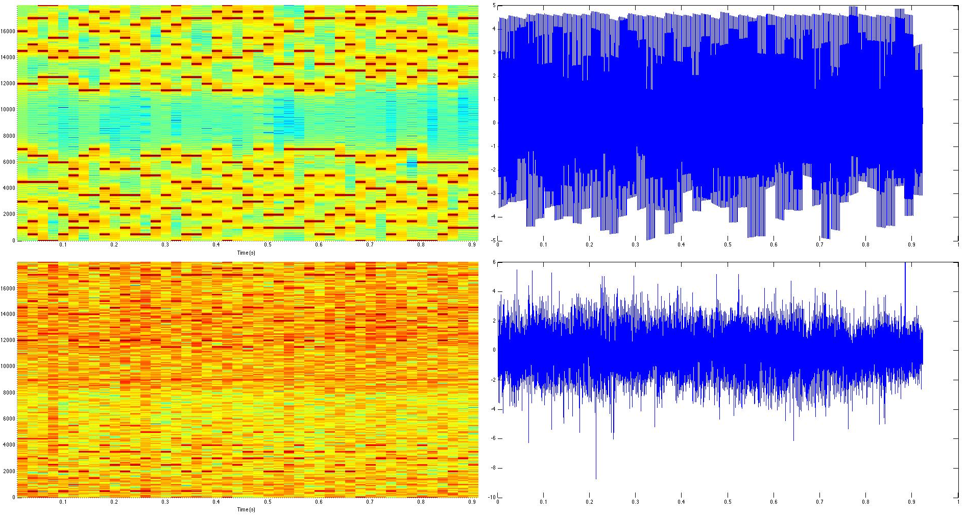
SPECTROGRAM FOR HIGH BER SIGNALS
Transmitted Signal
Received Signal

Slide 13
POWER SPECTRUM OF HIGH BER SIGNALS
Transmitted Signal
Magnitude
dB scale
Received Signal
Magnitude
dB scale

Slide 14
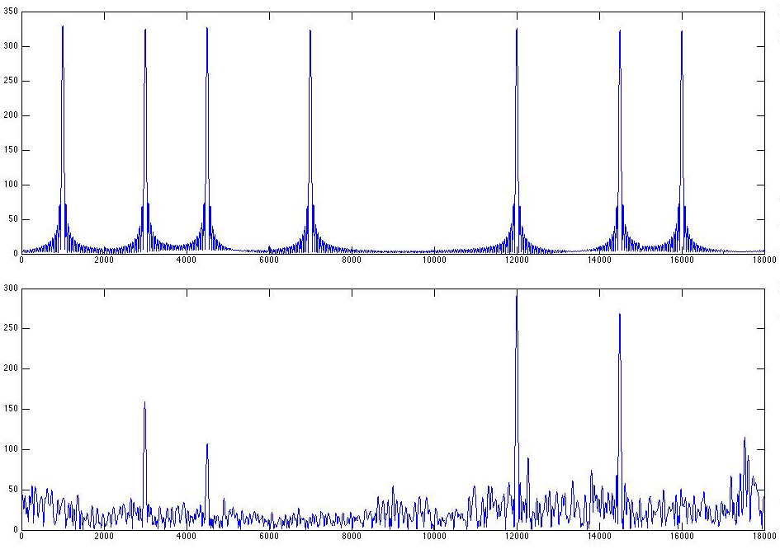
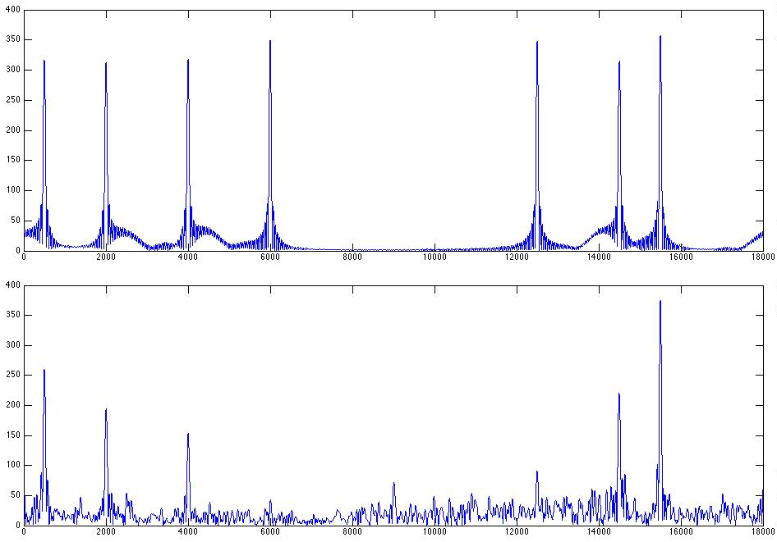
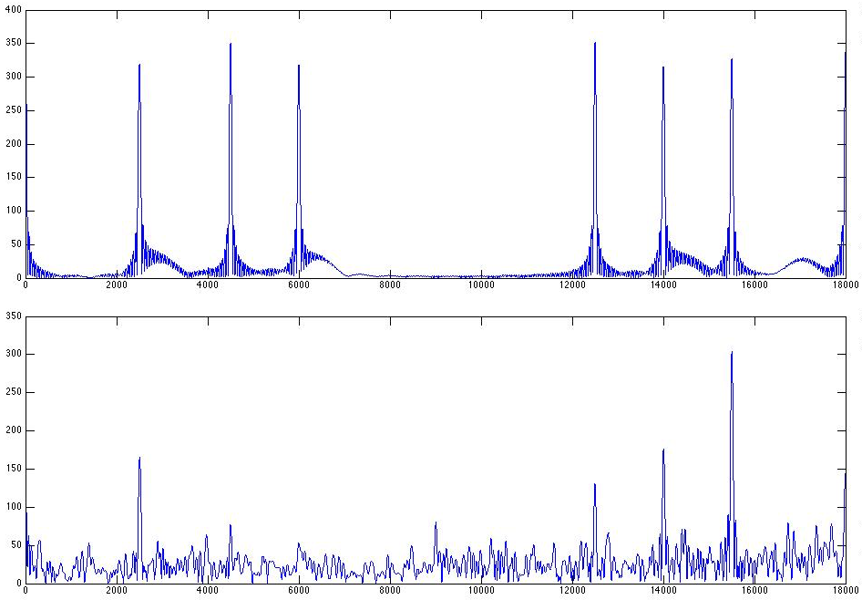
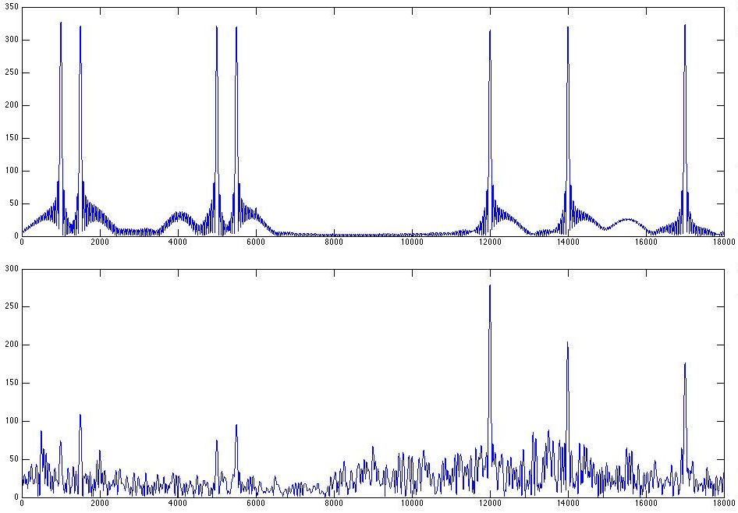
POWER SPECTRUM OF HIGH BER SYMBOLS
Transmitted Signal
Transmitted Signal
Received Signal
Received Signal
Transmitted Signal
Transmitted Signal
Received Signal
Received Signal

Slide 15
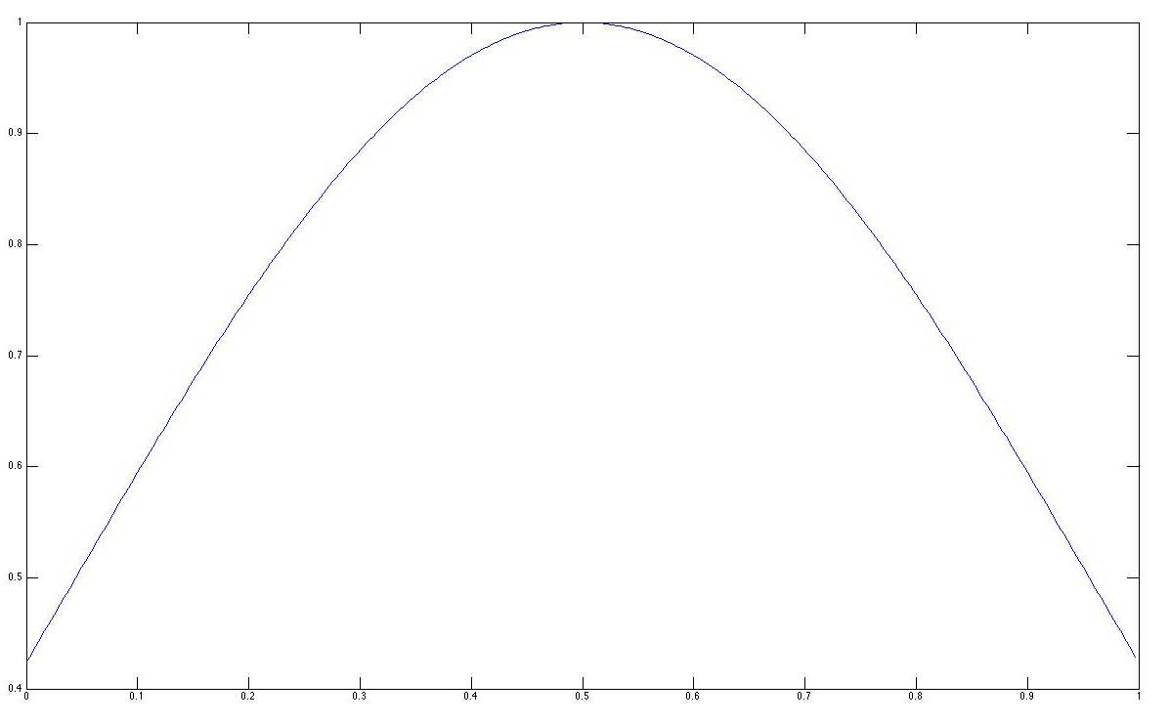
FURTHER PERFORMANCE IMPROVEMENT
Using root raised cosine windows at the transmitter and the receiver
P-norm instead of magnitude
Root Raised Cosine Window with roll off factor 0.7

Slide 16
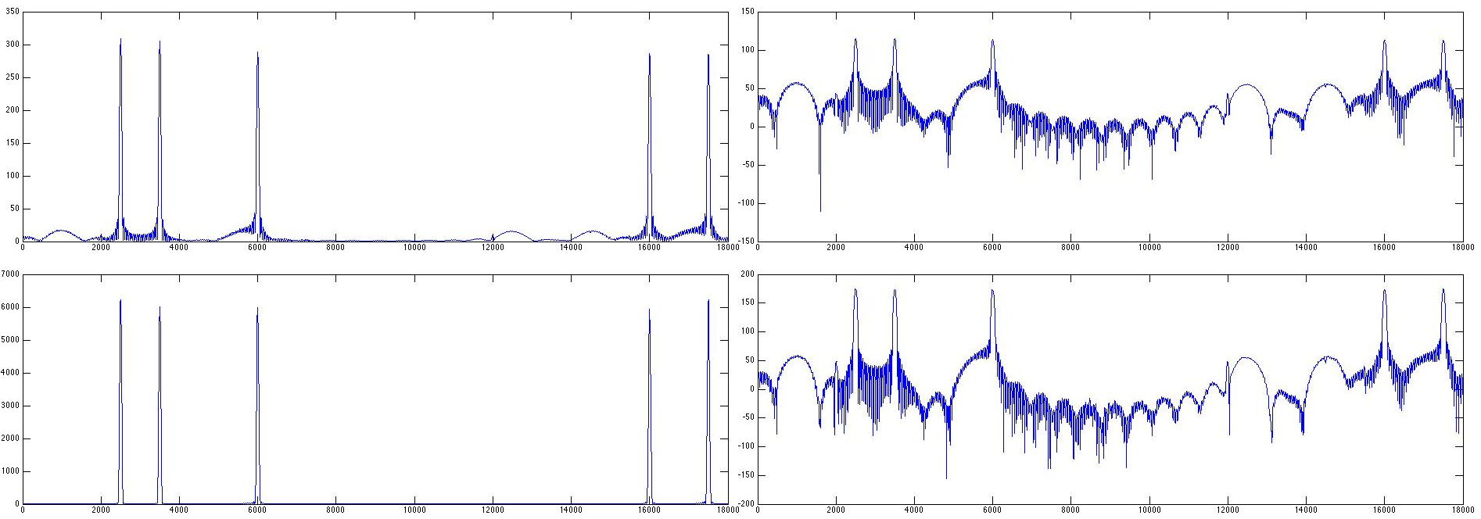
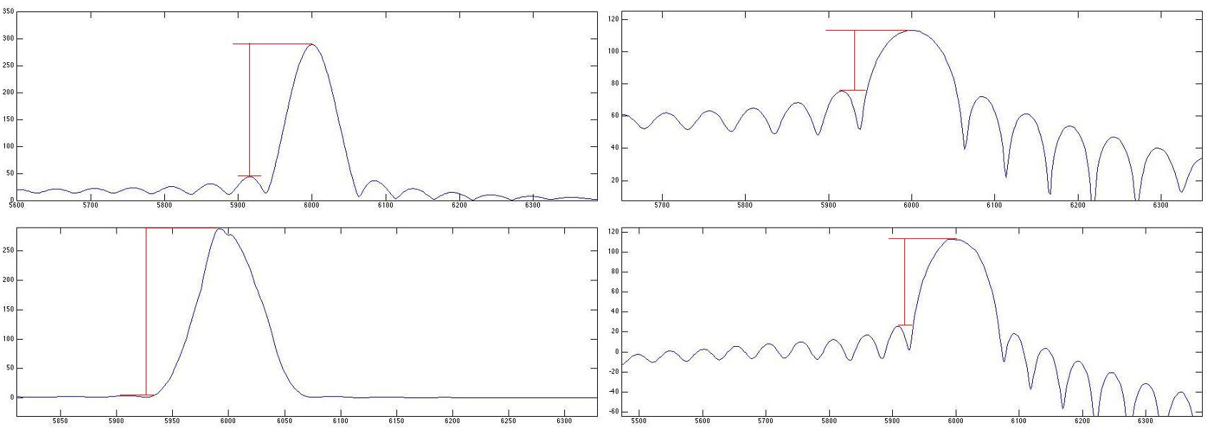
FURTHER PERFORMANCE IMPROVEMENT
Magnitude
dB Scale
No window
38 dB
245
286
88 dB
Root Raised Cosine Window + p-Norm ( p=1.7 )

Slide 17
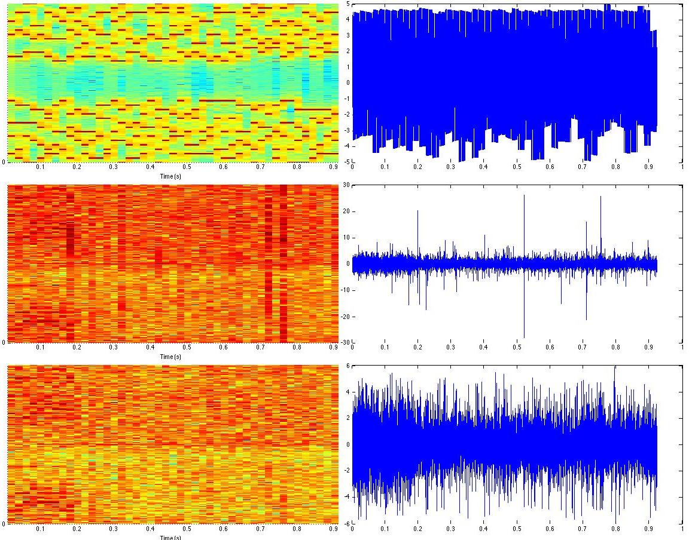
FURTHER PERFORMANCE IMPROVEMENT
Clipping
Transmitted Signal
No Clipping
Clipped

Slide 18
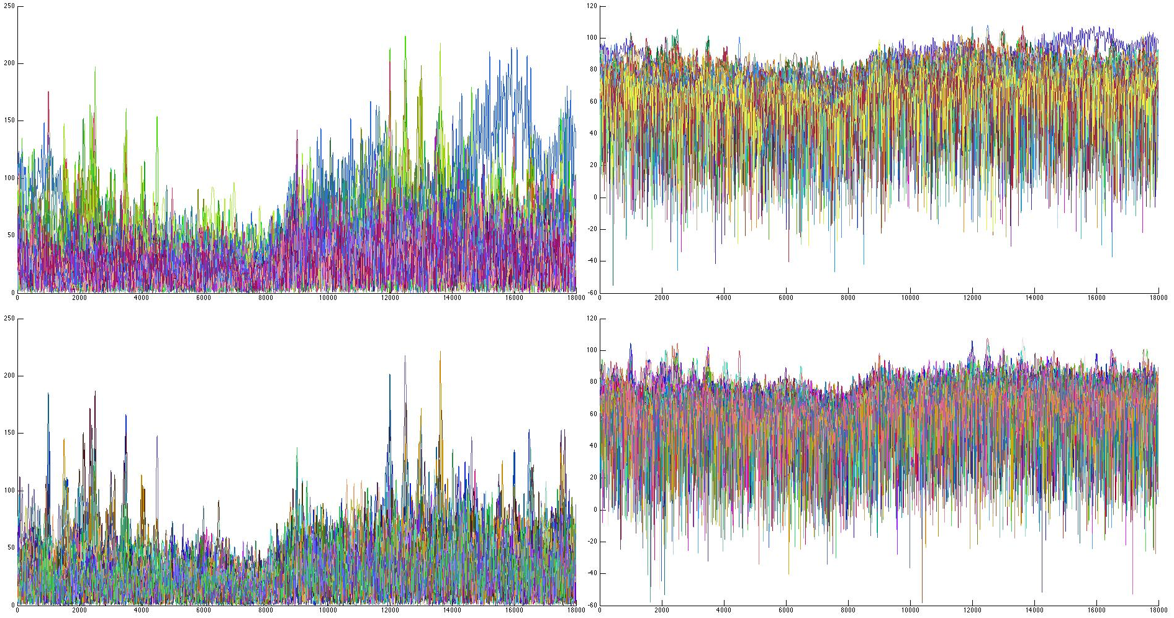
FURTHER PERFORMANCE IMPROVEMENT
Clipping
No Clipping
Magnitude
dB Scale
Clipped
dB Scale
Magnitude

Slide 19
THANK YOU

